Slide 1
Changing tides: How estuary restoration impacts Sitka spruce
Stillwaters Environmental Center | Hanna Brush | April 2022

Slide 2
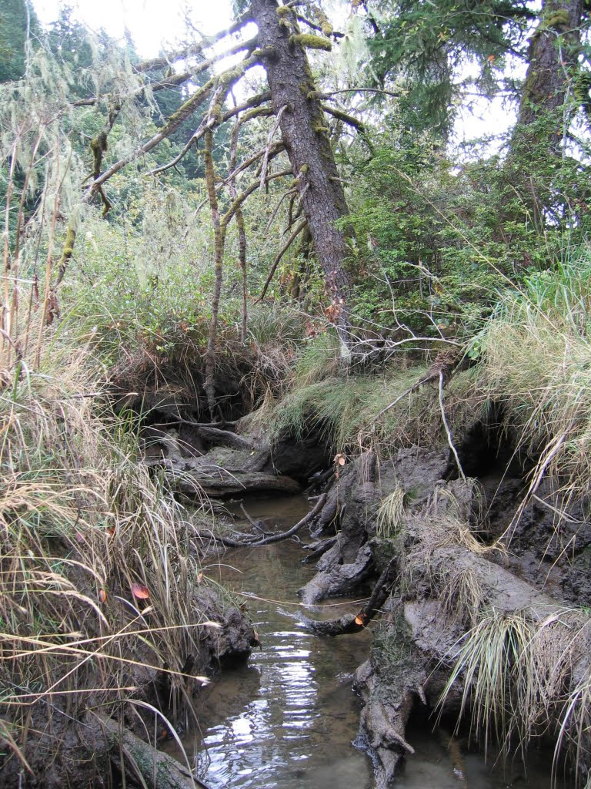
Sitka spruce in salt marshes
Picea sitchensis is a large and long-lived species
Grow on nurse logs as seedlings, leave behind large buttresses
Very salt and moisture tolerant, dominating Northwest salt marshes
These tidal swamps store more carbon than almost any other ecosystem on earth
Institute for applied ecology

Slide 3
Sitka spruce in decline
Many Sitka spruce in the Carpenter Creek estuary are dying
What major changes could have caused this?

Slide 4
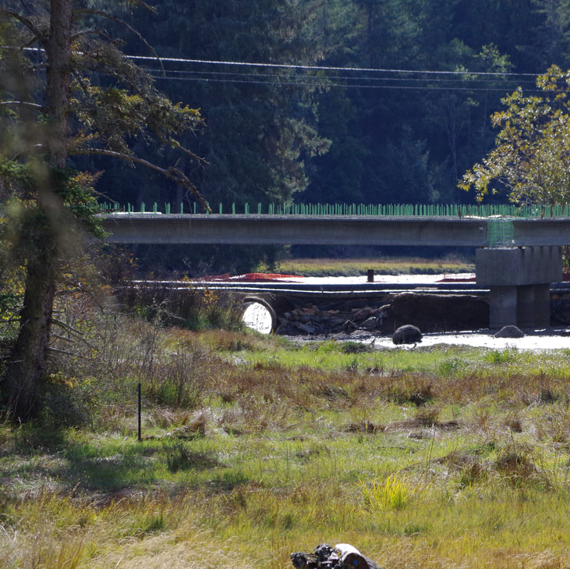
Culvert removal
Stillwaters spearheaded the removal of culverts in 2012 and 2018
Replaced with bridges
Allowed free flow of sediment and water

Slide 5
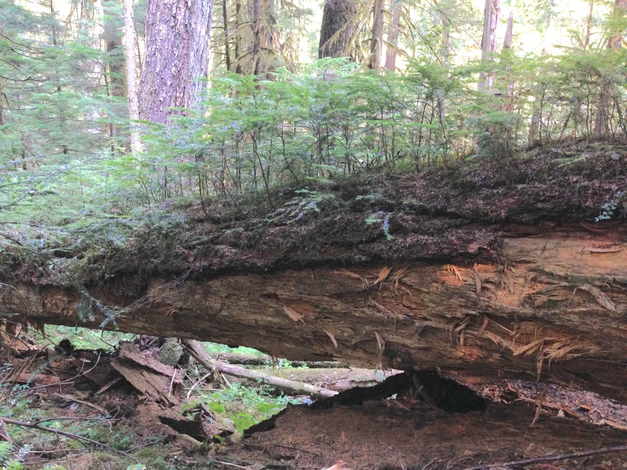
Tree death isn’t necessarily bad
Ingrid Science

Slide 6
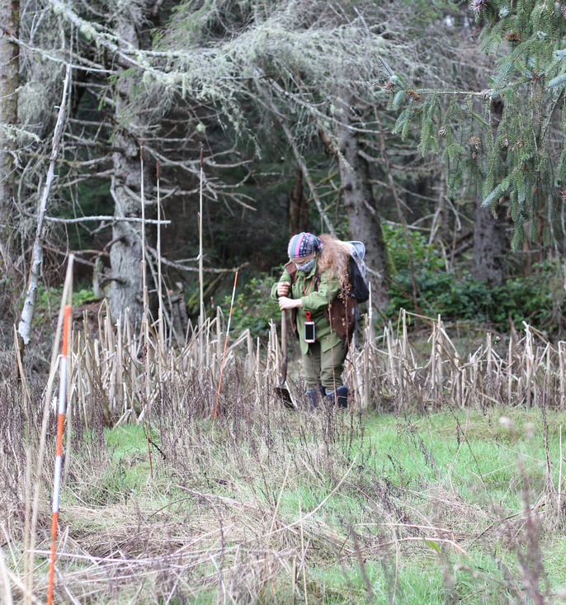
Seedling planting project
120 seedlings planted
Thanks to generous donors and volunteers
Monitored:
Survival
Soil moisture
Soil salinity
Other variables

Slide 7
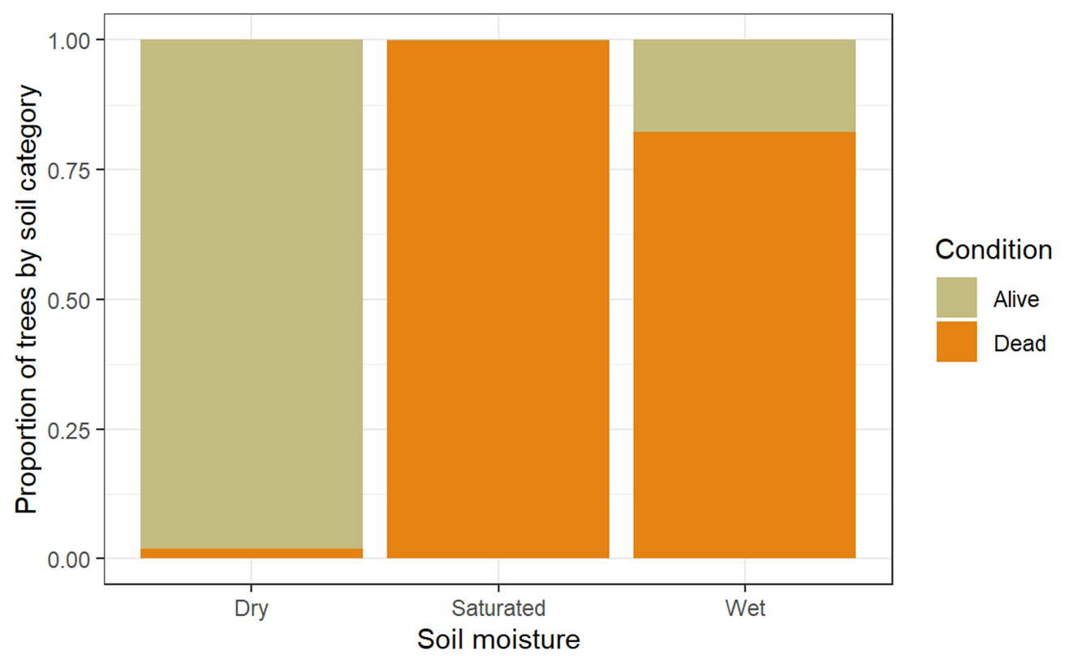
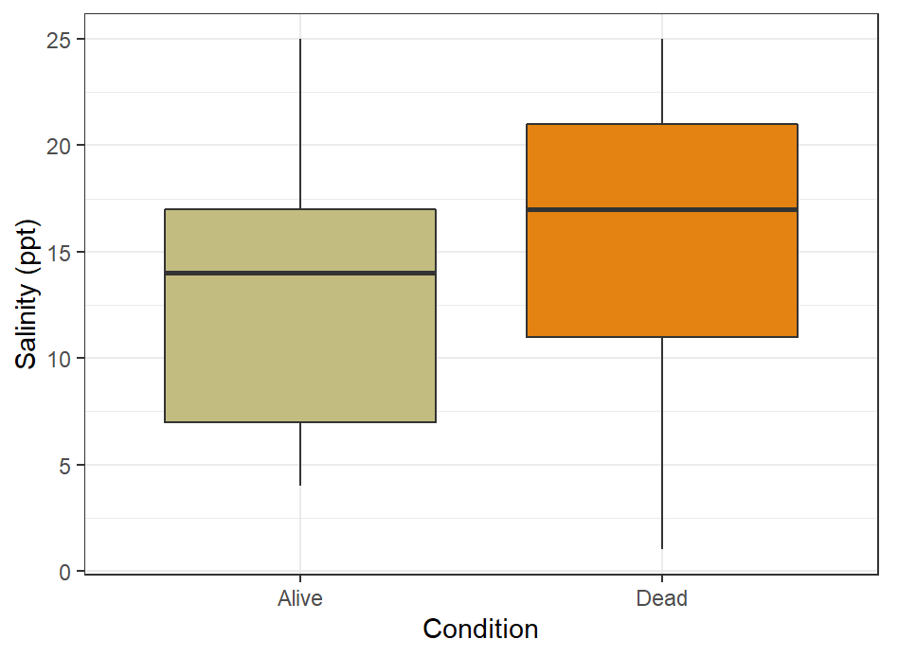
Soil Moisture Soil Salinity

Slide 8
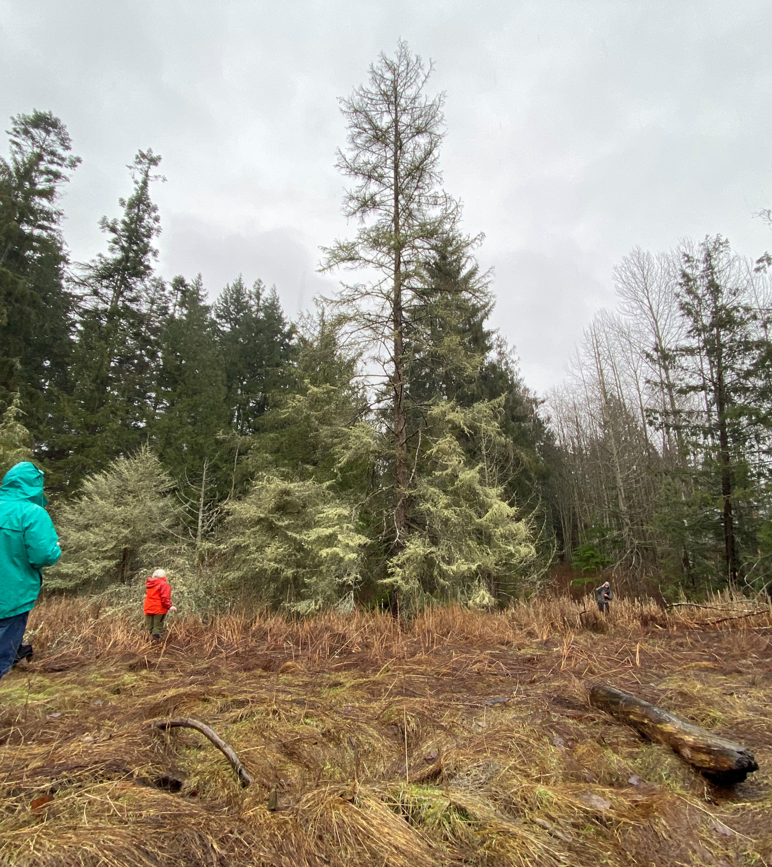
What’s killing Sitka spruce?

Slide 9
Central questions
Which factors are related to Sitka spruce health?
Age
Soil Moisture
Soil Salinity
Location
Does the timing of culvert removals coincide with changes in growth?

Slide 10
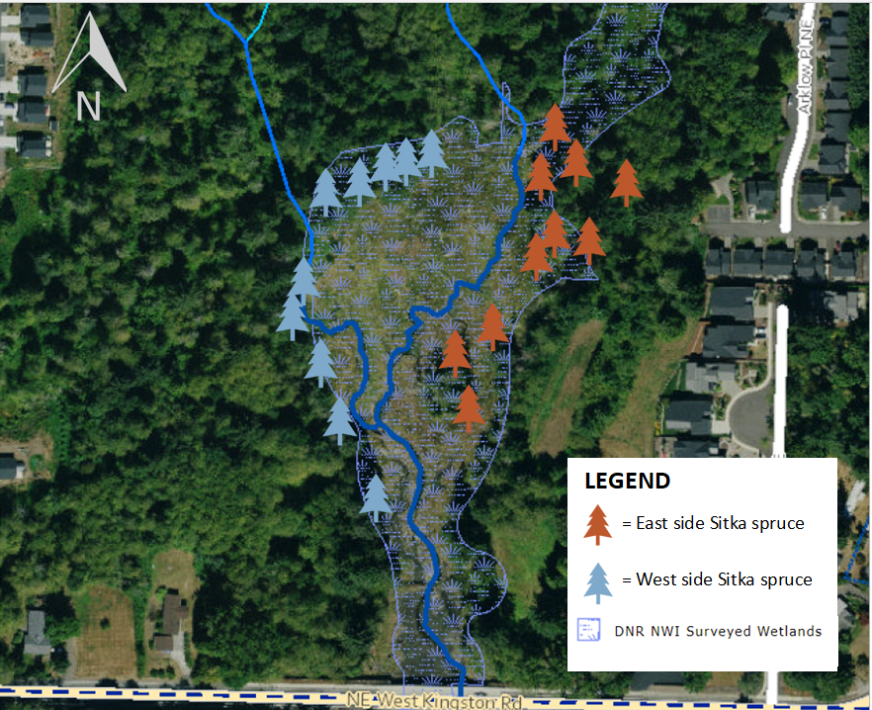
Study tree locations
Trees on the east and west sides of the marsh may experience differing environmental conditions

Slide 11
Measuring tree health
Percent live foliated crown (PLFC)
How much of the canopy is growing green needles?
Ward Ecosystem Research

Slide 12
Tree age
Height is a good proxy for age
Measure tree height and compare it to PLFC measurements
Rangefinder measures lengths and angles to find height
Nikon

Slide 13
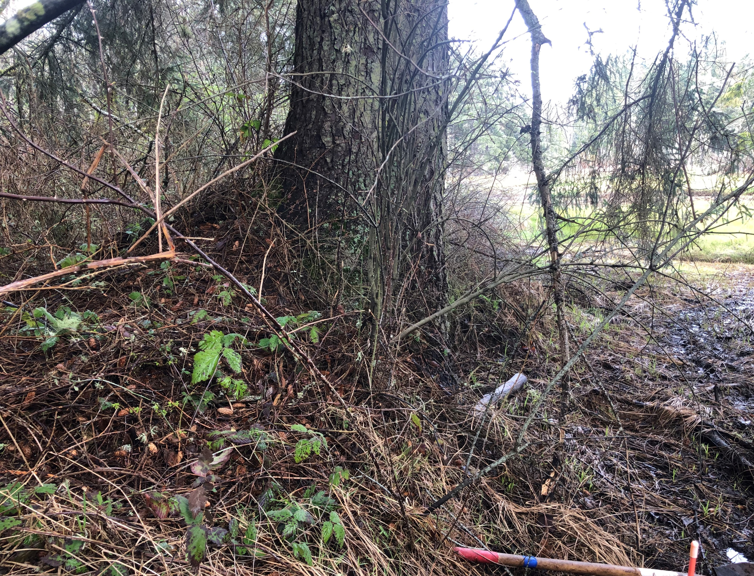
Collecting soil samples
Collected soil samples at 0.35m depth
One from the upland side of the tree, one from the salt marsh side
UW Madison

Slide 14
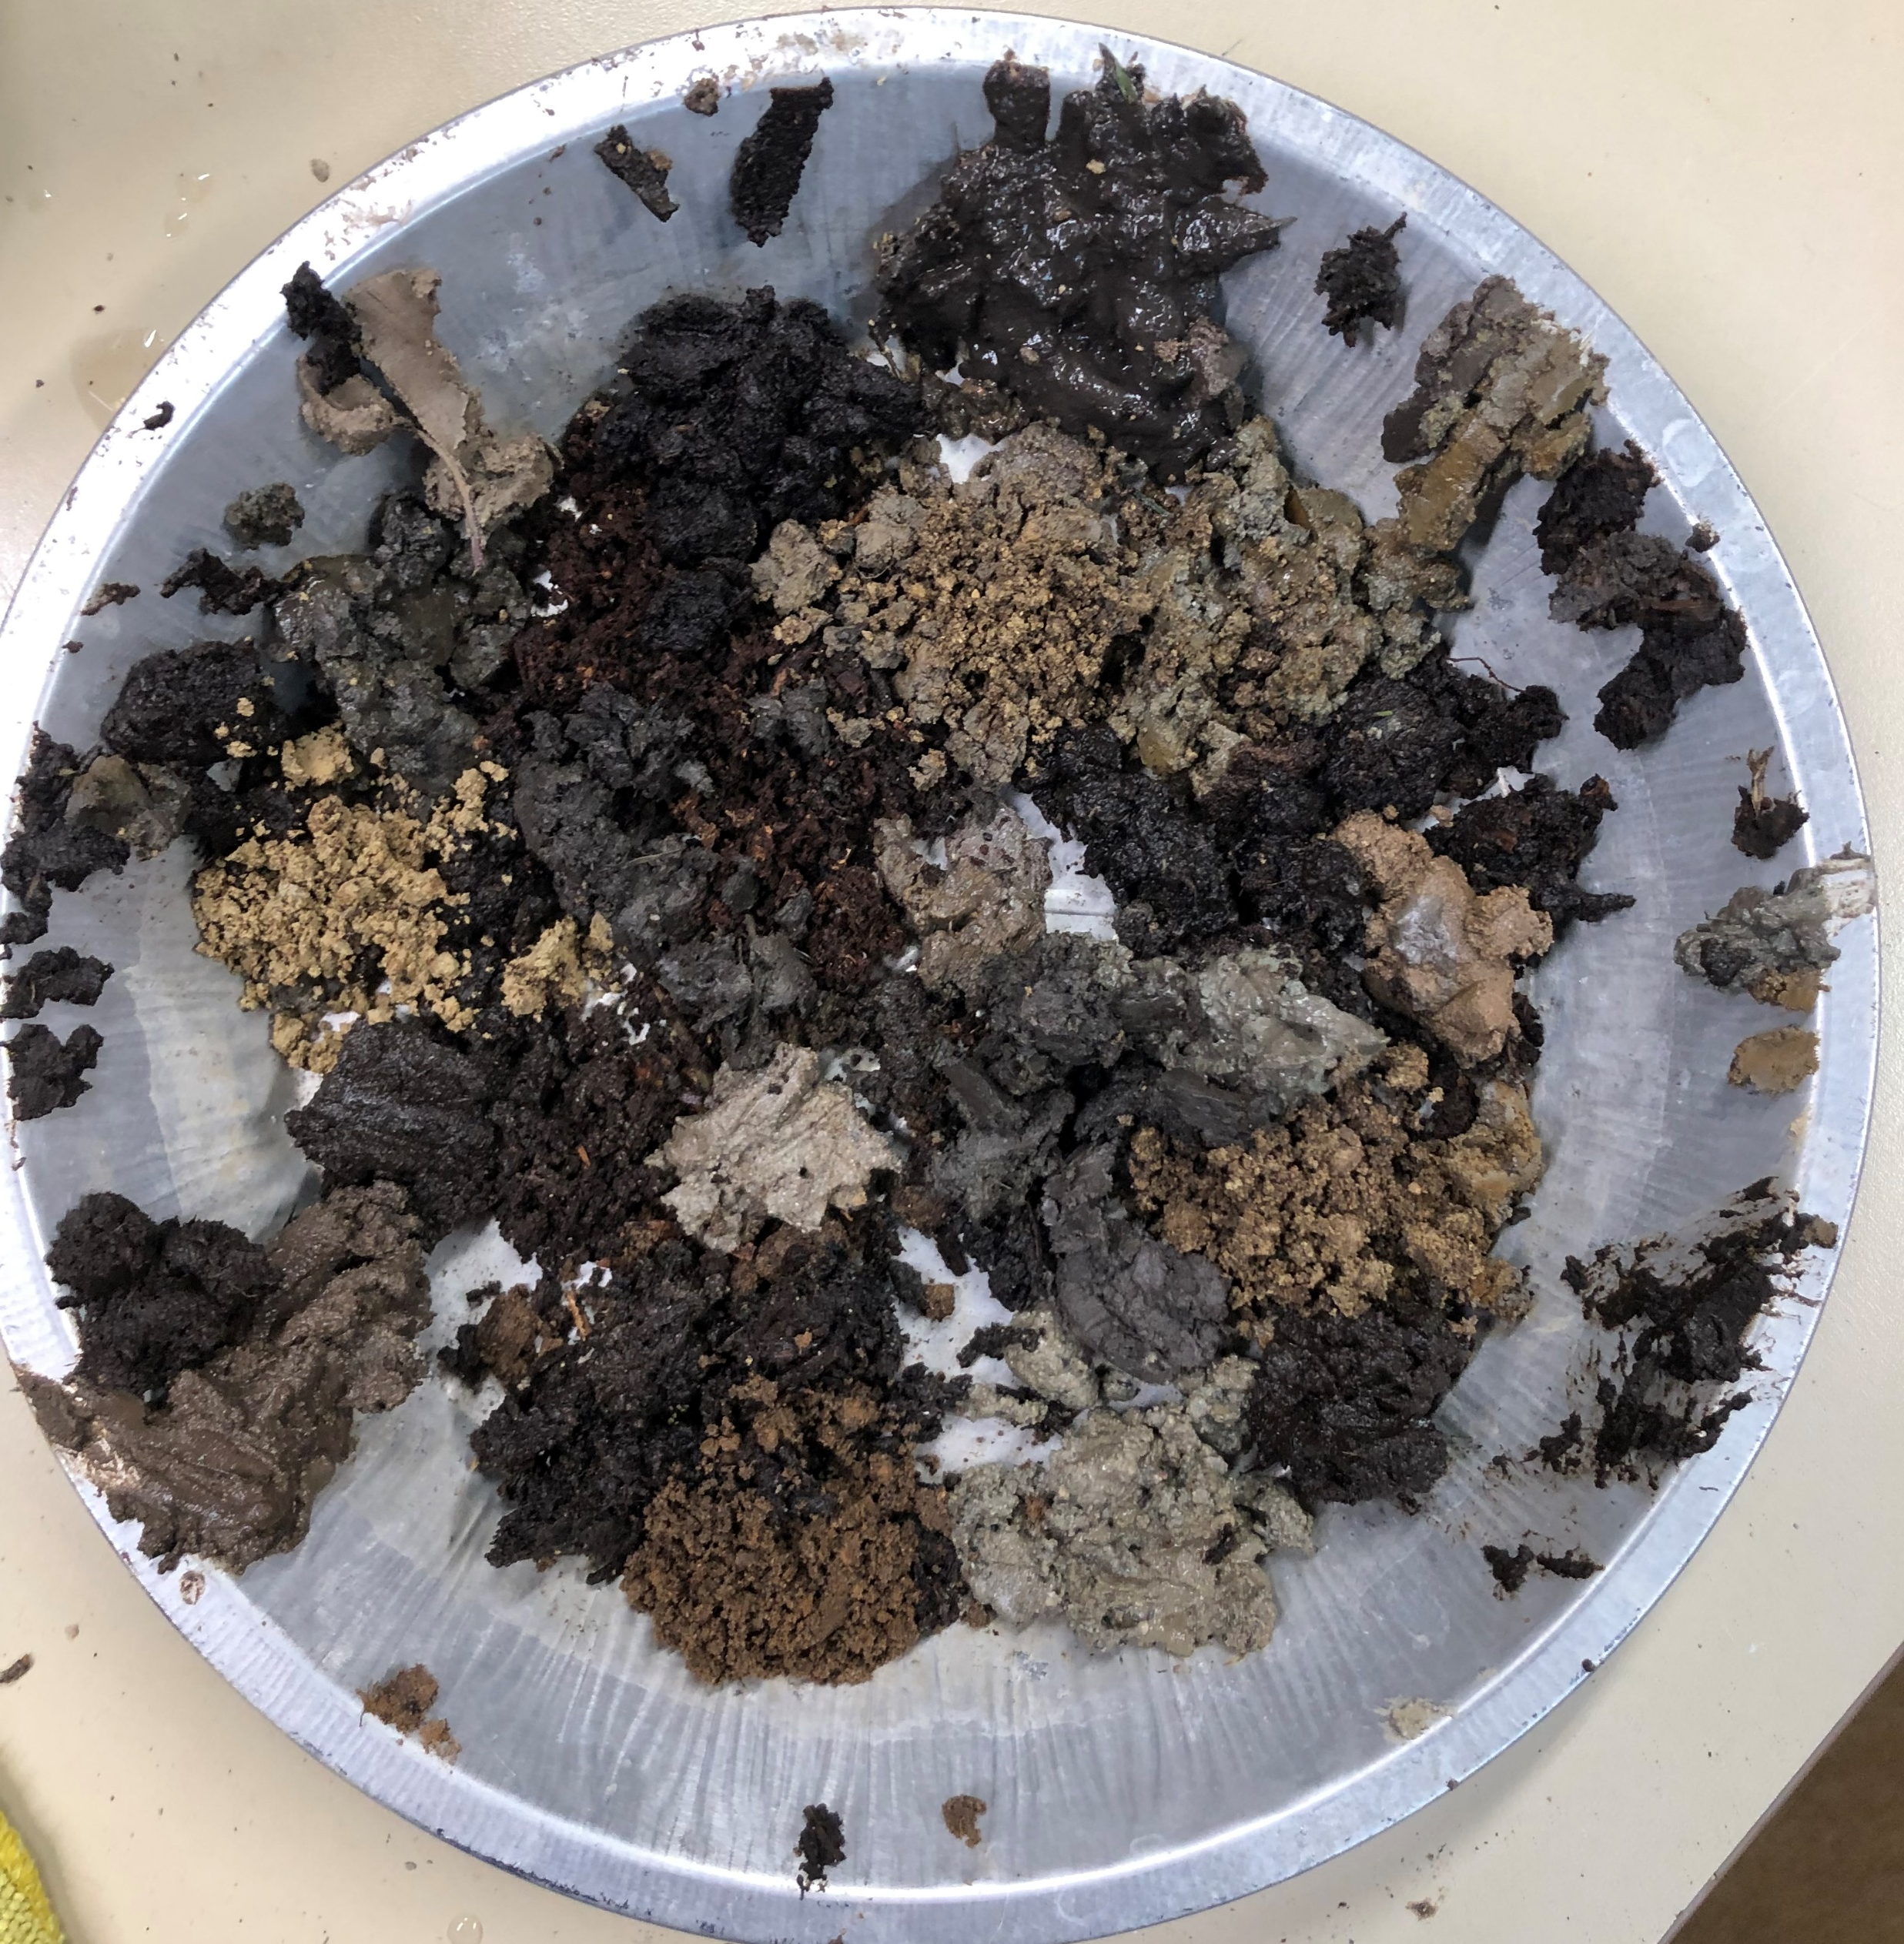
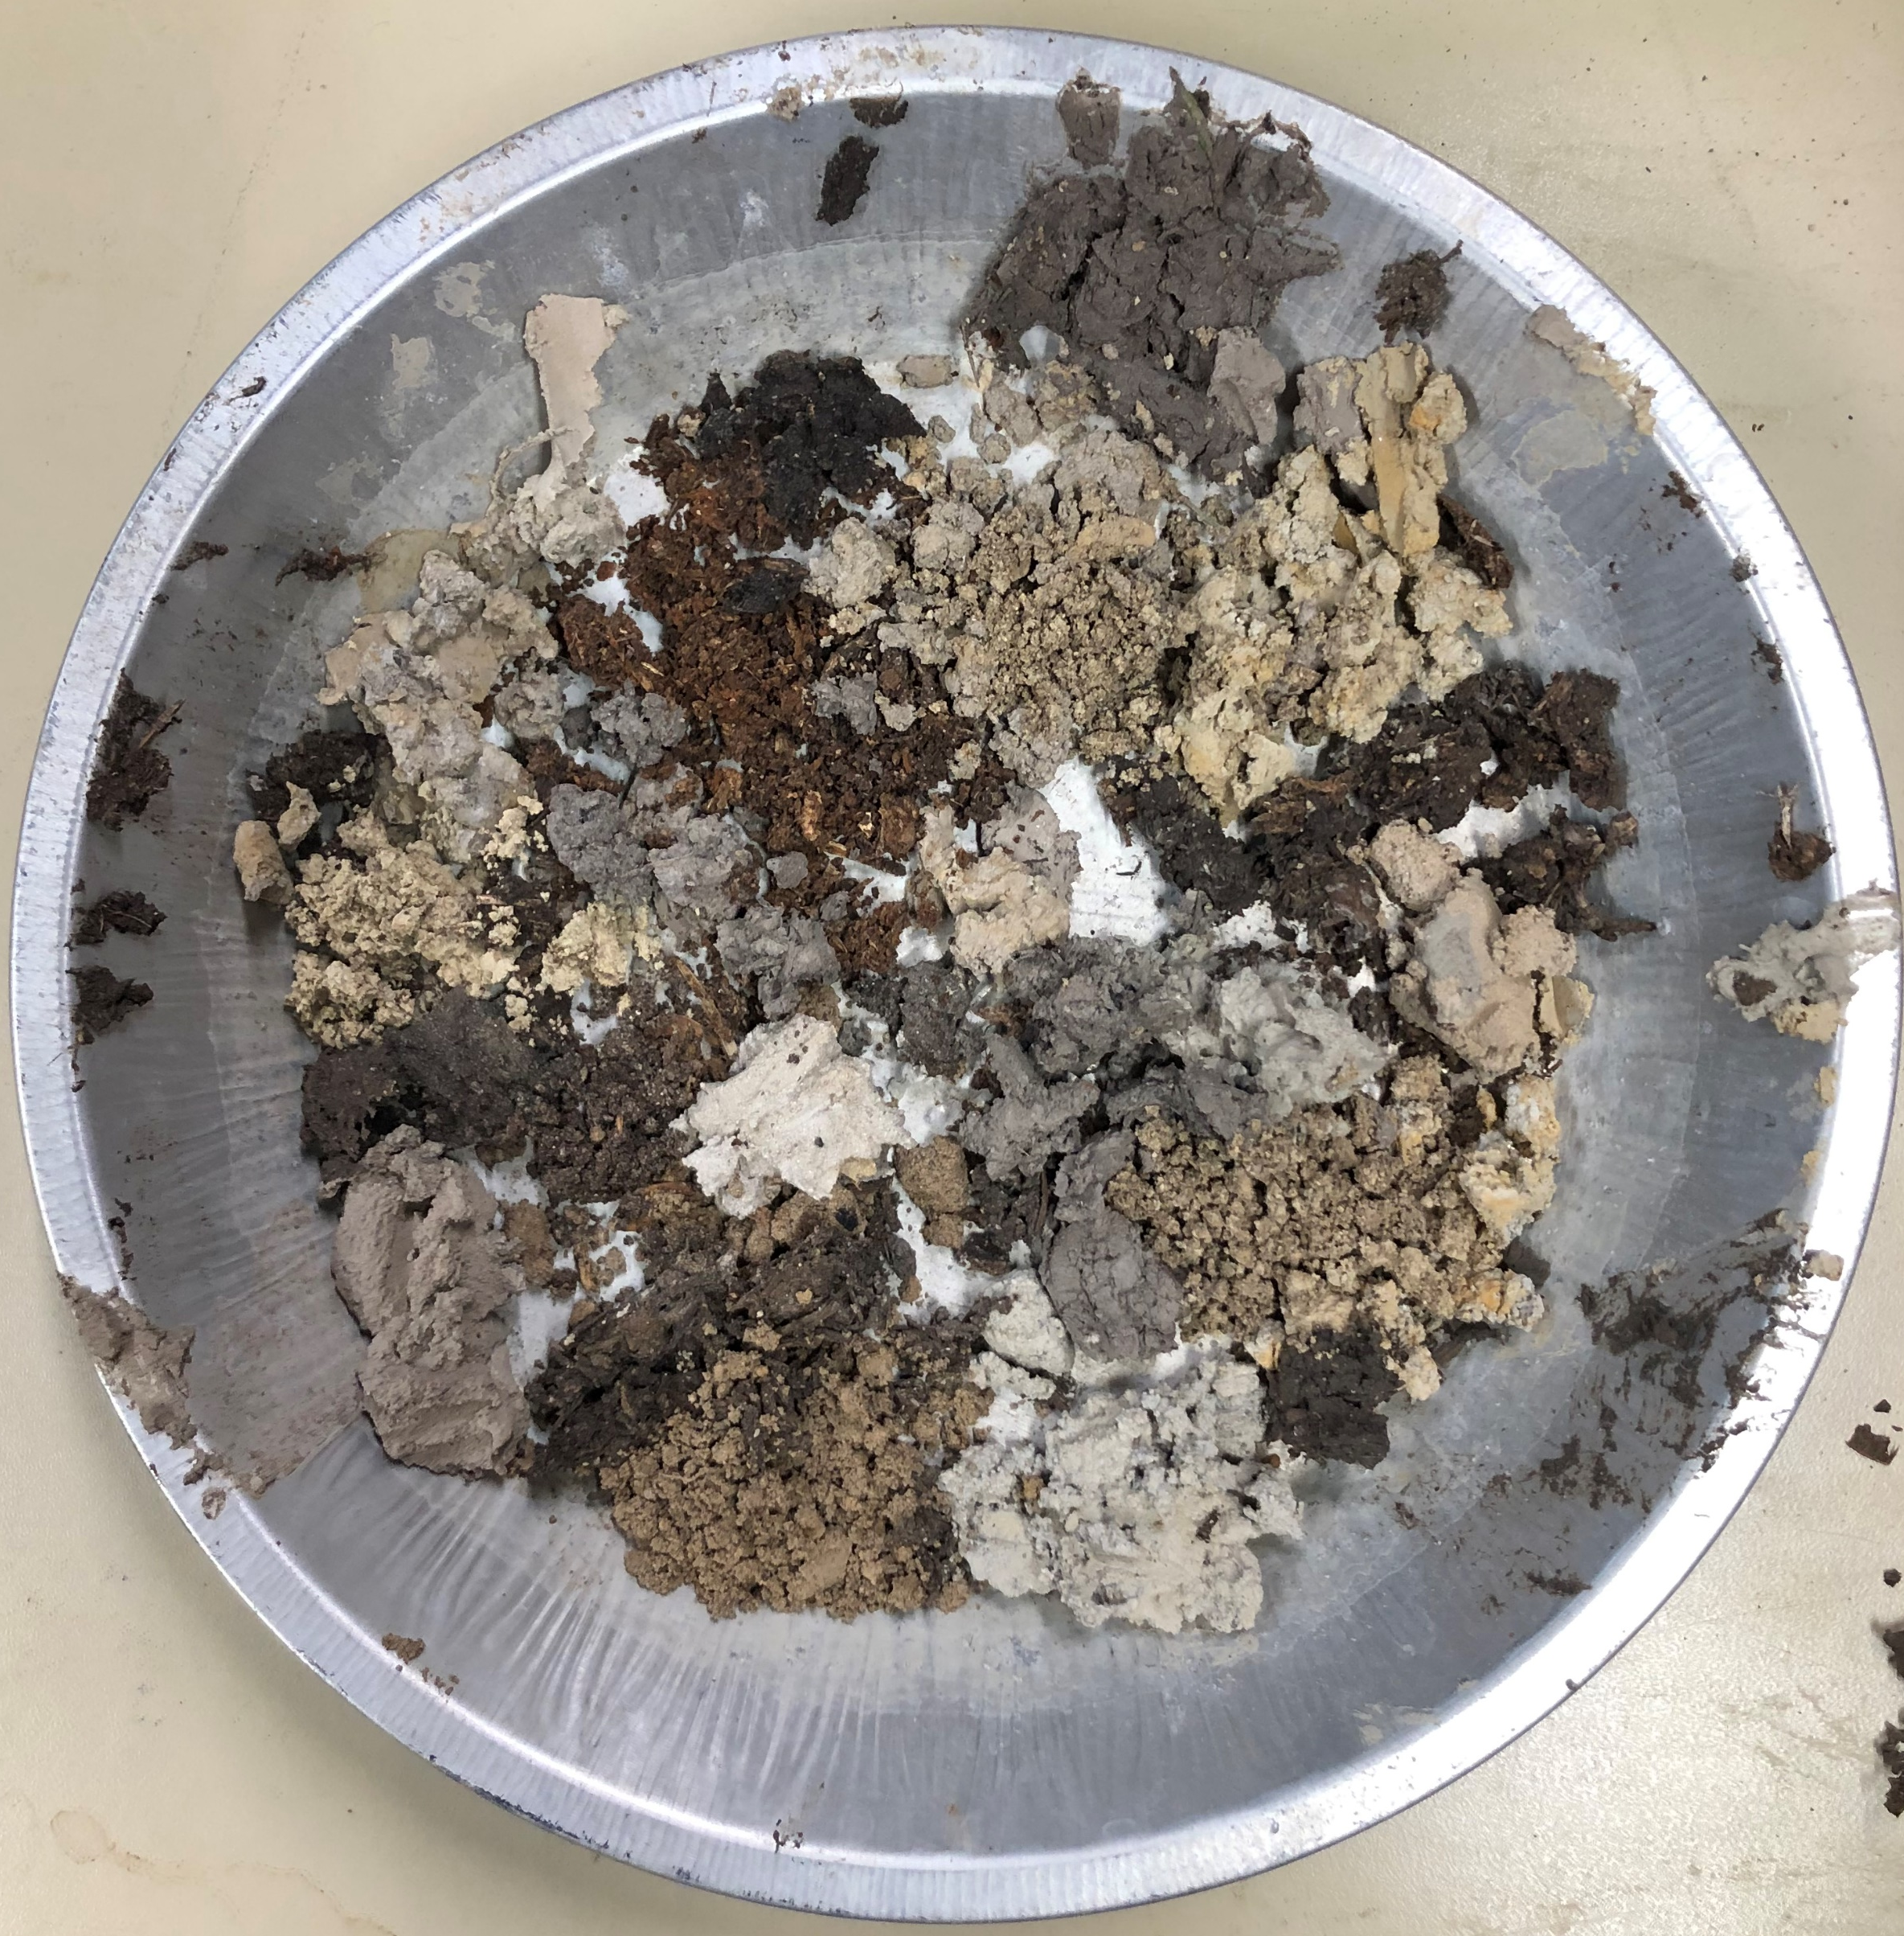
Soil Moisture
Wet
Measure soil moisture at the roots
Mass sample before drying – mass sample after drying = mass water in sample
Dry

Slide 15
Soil salinity
Rehydrated soil samples and measured salinity in the water
Electrical Conductivity used as proxy

Slide 16
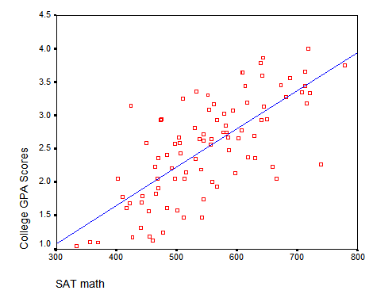
Building models
Which variables best predict our observed outcomes?
Observed outcome: Tree health (PLFC)
Variables:
Height (Age)
Salinity
Moisture
Location

Slide 17
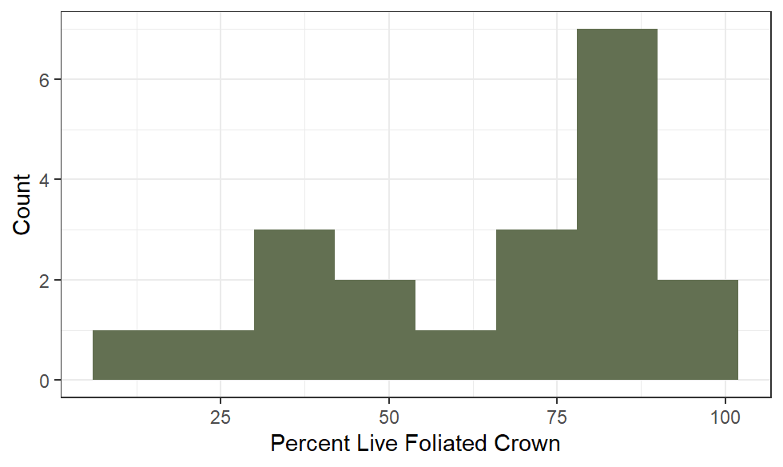
Sitka spruce health

Slide 18
Tree age

Slide 19
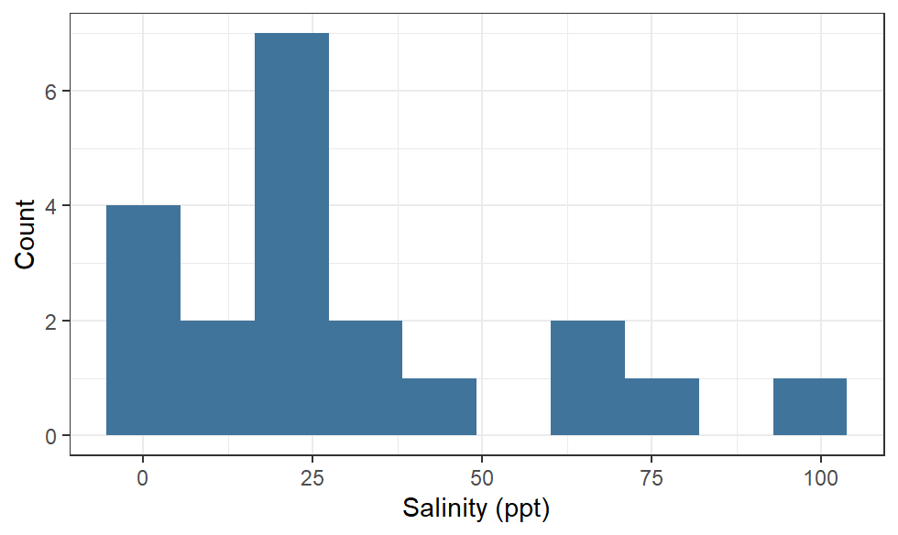
Soil salinity
Excess soil salinity known to cause Sitka spruce mortality
Zhang et. al. 2021
Average salinity of seawater: 35 ppt

Slide 20
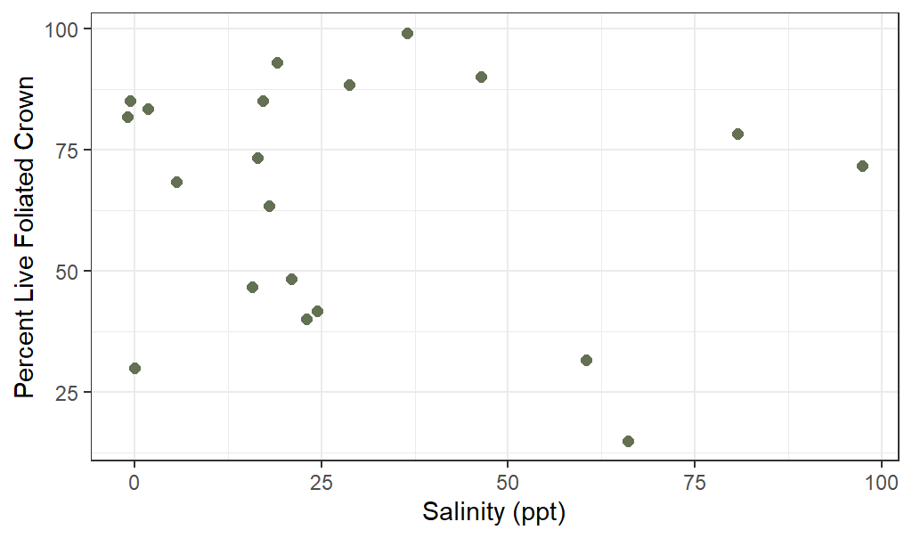
Soil salinity

Slide 21
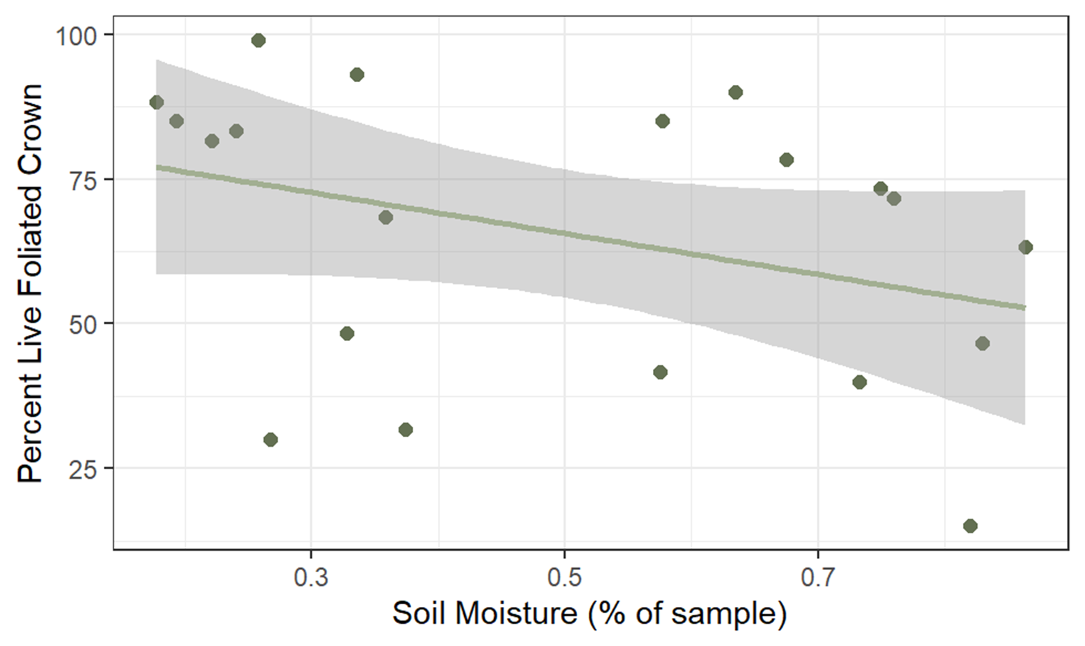
Soil moisture
P = 0.163

Slide 22
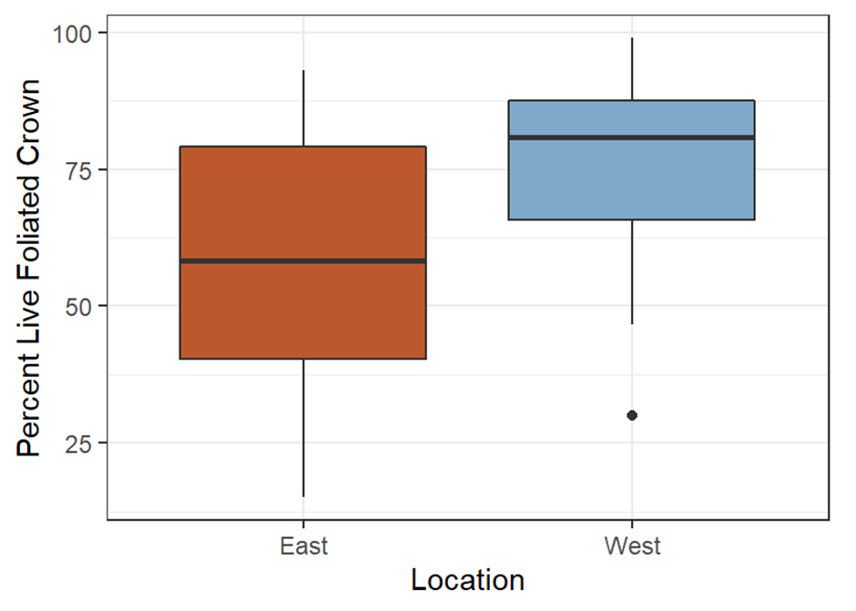
Location
P = 0.156

Slide 24
Building models
Which variables best predict our observed outcomes?
Height (Age)
Salinity
Moisture
Location
Moisture + Location

Slide 25
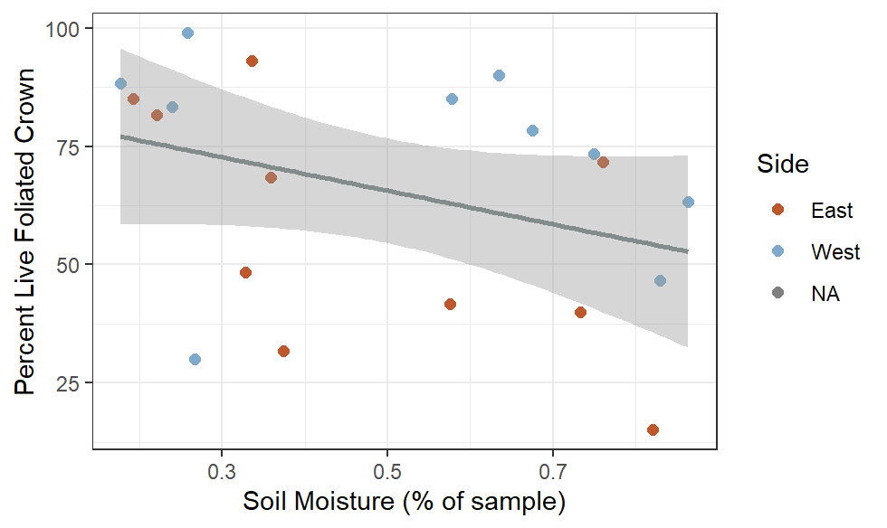
Winning model: Soil moisture + Location
P < 0.01
Tree health depends on the soil moisture and its location in the salt marsh

Slide 26
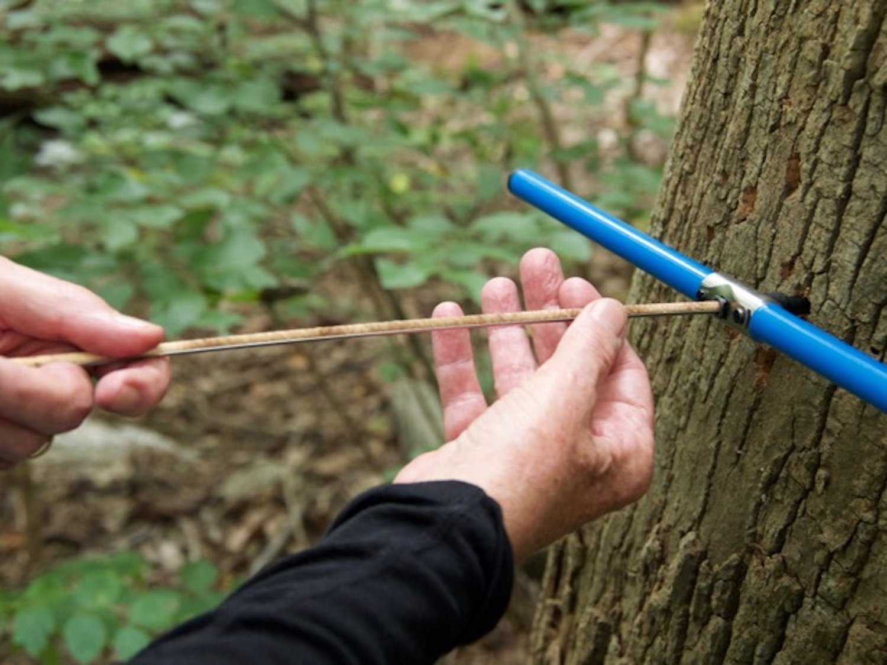
Does the timing of culvert removals coincide with changes in growth?
Looking for visible growth changes in tree rings
Collect tree cores in the field
Analyze them in the lab
Measure how wide the rings are, and if that width changes over time
The Chestnut Hill Local
UVM

Slide 27
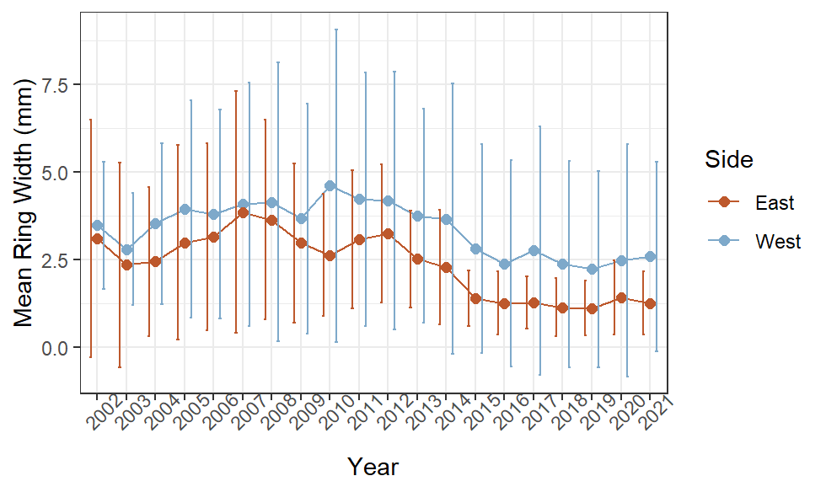

Slide 28
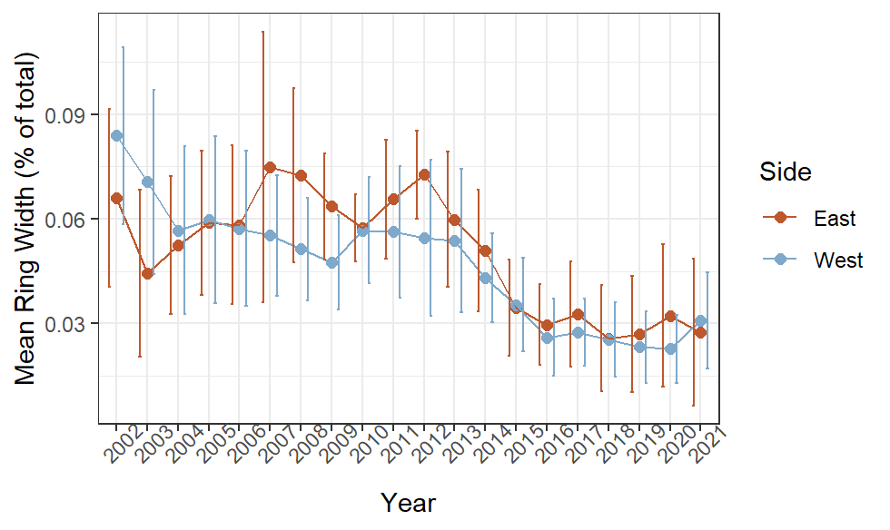

Slide 29
Culvert removal’s impact on Sitka spruce
2012: Culvert removal
Increased tidal inundation
Sitka spruce growth declines

Slide 30
Ecological implications

Slide 31
Boundary expansion
More seawater = more salt marsh
Species with higher tolerance replace Sitka spruce
Coarse woody debris
Management responses
Planting in upland sites
Continued monitoring

Slide 32
Applications
Estuary restoration
Climate change
Opening wetlands to seawater can have unintended effects
Increased storm surges
Sea level rise

Slide 33
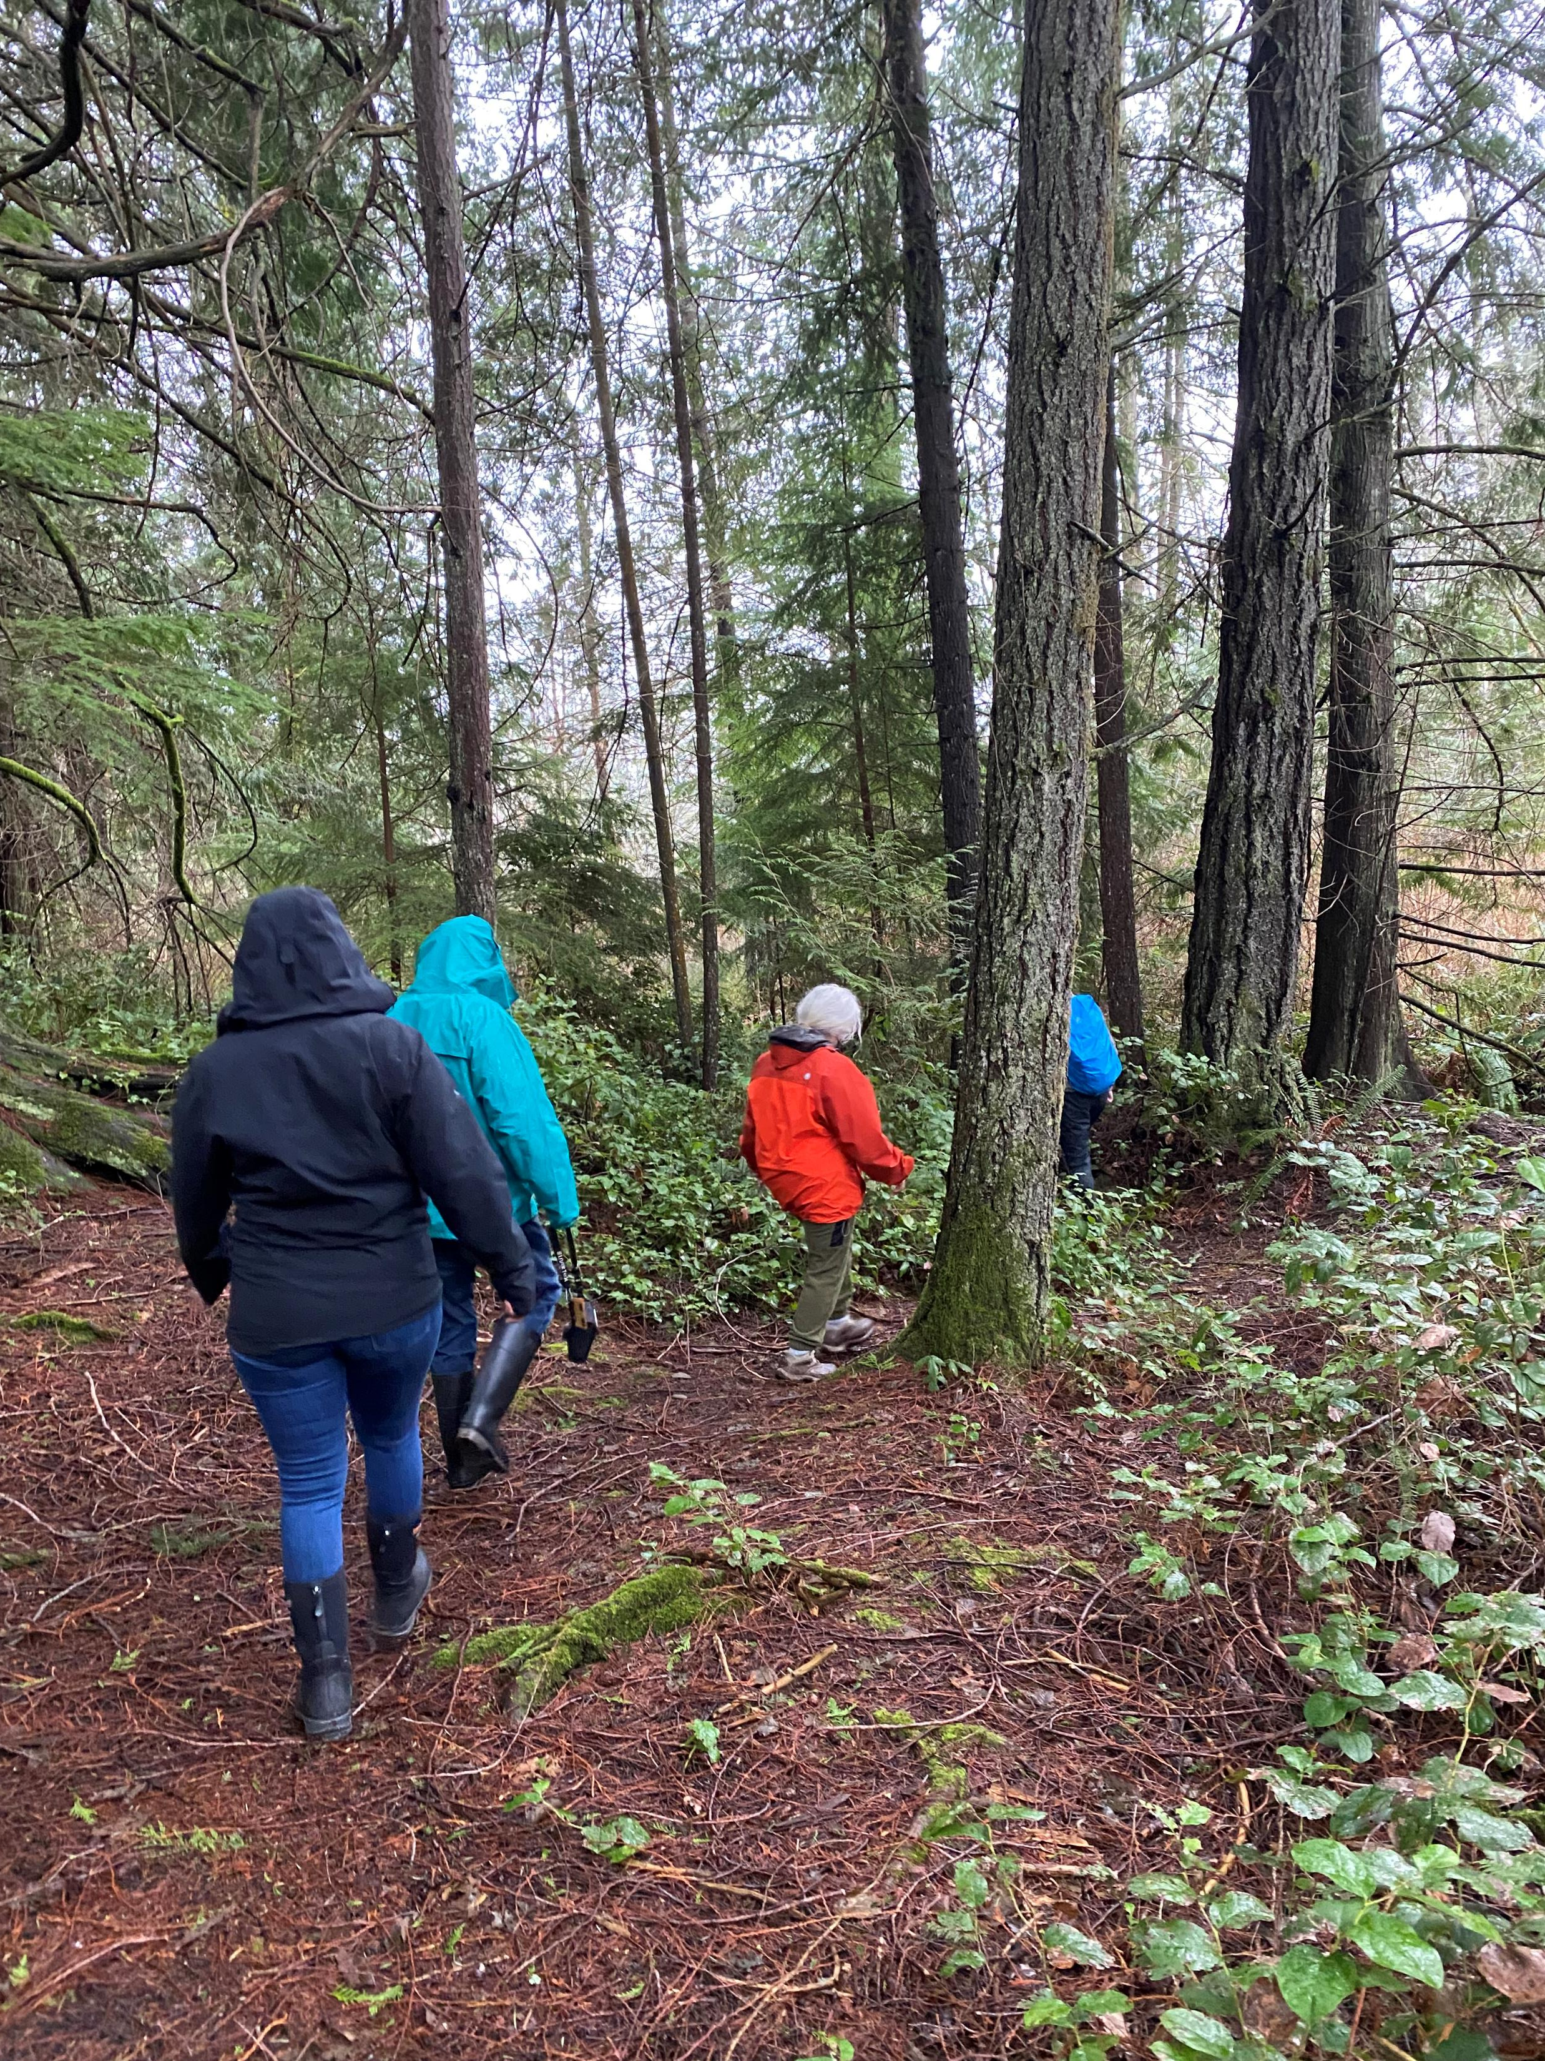
Acknowledgements
Stillwaters College Interns
Maddie Rutter, University of Washington
Sara Mahmud, Western Washington University
Stillwaters volunteers

Slide 34
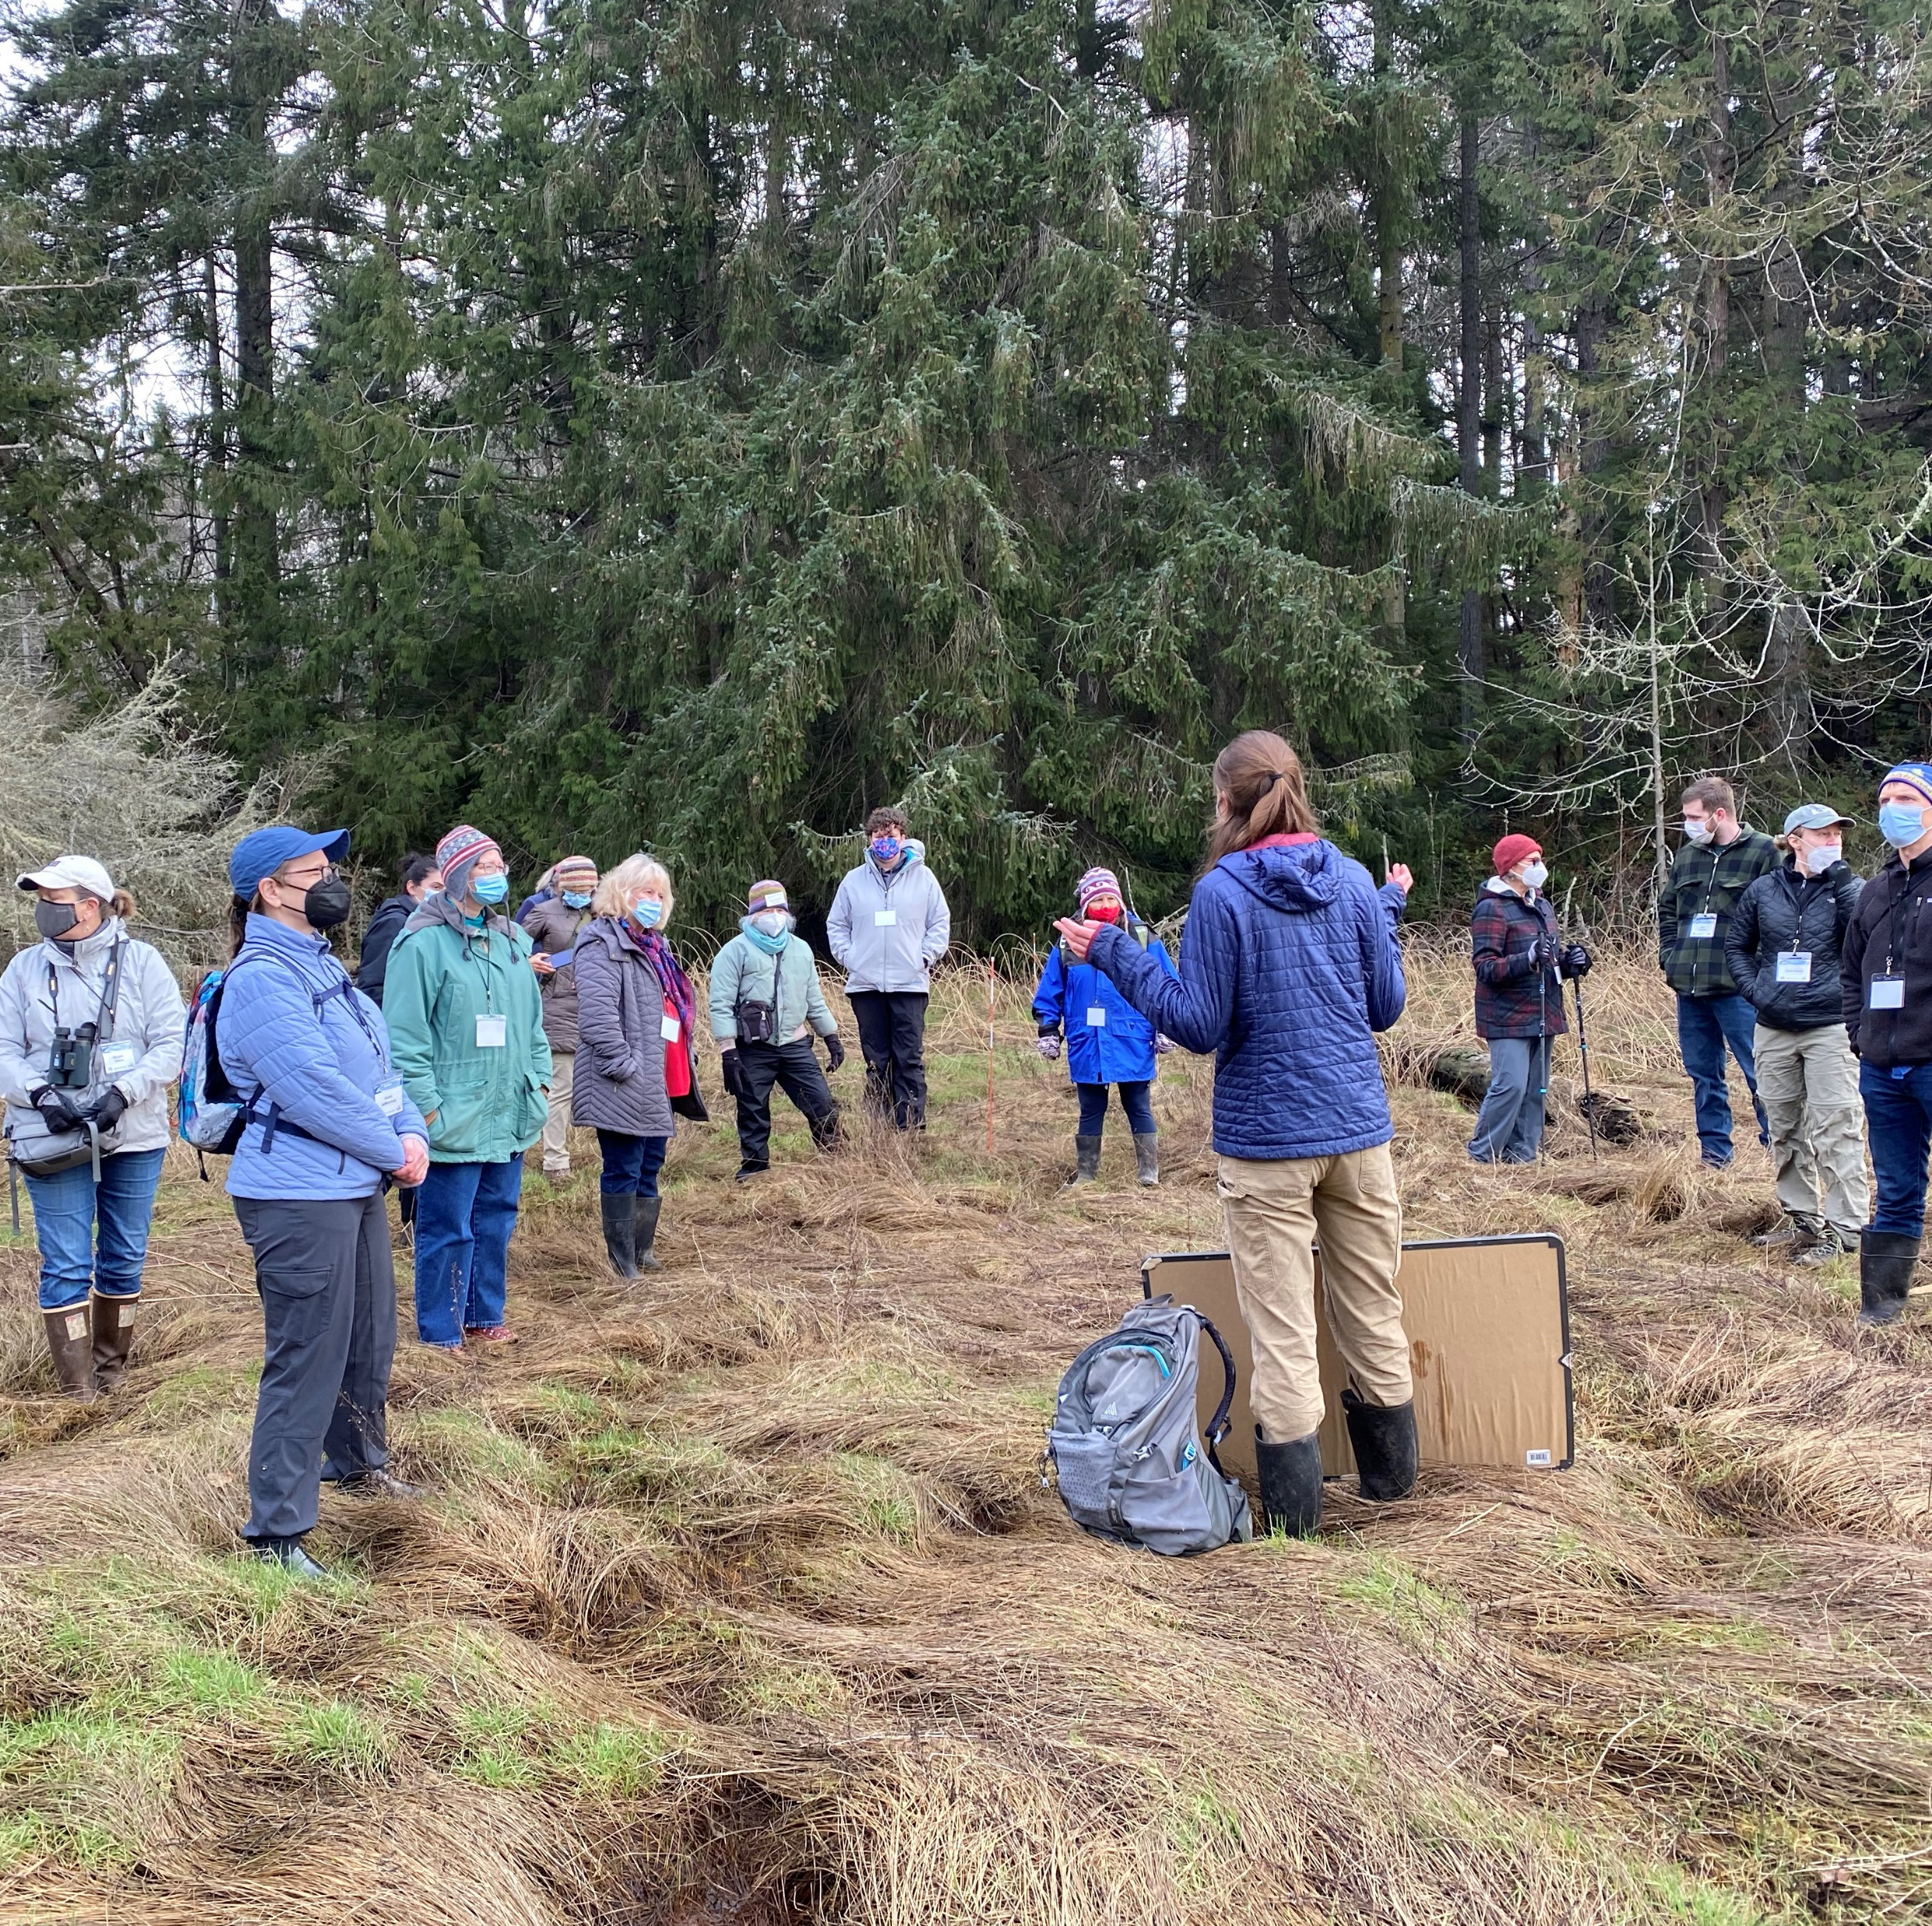
How you can help Stillwaters
Donations greatly appreciated
Links in the chat
Or visit www.stillwatersec.org

Slide 35
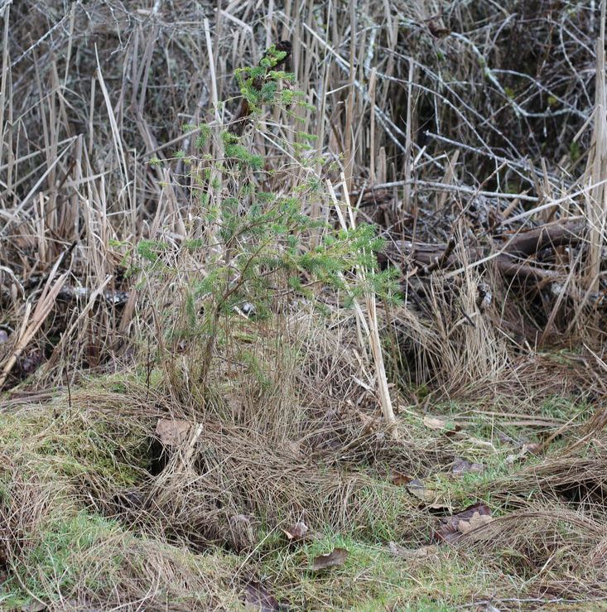
Thank you!
Questions?

